Slide 1
“Optimal Power Allocation and Channel Estimation in NOMA based Wireless Systems”
Major Project Synopsis Presentation
on
Under the guidance of:
Mrs. K. V. Nagalakshmi,
Associate Professor,
Dept. of ECE, NIE
Dr. Naveen M. B,
Assistant Professor,
Dept. of Electrical Engg,
IIT Dharwad
Presented By:
Saishree Kiran Gaonkar 4NI16EC085
Shiva Prasad S 4NI16EC094
Yashwanth R 4NI16EC112
Soumya Mutalik 4NI17EC419
Presented on: 10/10/2019

Slide 2
Contents
Introduction 3
Literature Survey 4
NOMA: Block Diagram 6
NOMA: System Model 7
NOMA: Channel Estimation 8
NOMA: Power Allocation 11
Problem Statement and Methodology 13
Applications and Advantages 14
References 15

Slide 3
Introduction
NOMA: Non Orthogonal Multiple Access.
NOMA Types: Power Domain and Code Domain
OFDMA: Orthogonal Frequency Division Multiple Access

Slide 4
Literature Survey
In general, NOMA schemes can be classified into two types: power-domain multiplexing and code-domain multiplexing. In power-domain multiplexing, different users are allocated different power coefficients according to their channel conditions in order to achieve a high system performance.
In particular, multiple users’ information signals are superimposed at the transmitter side. At the receiver side, successive interference cancellation (SIC) is applied for decoding the signals one by one until the desired user’s signal is obtained [1], providing a good trade-off between the throughput of the system and the user fairness. In code-domain multiplexing, different users are allocated different codes and multiplexed over the same time frequency resources, such as multiuser shared access (MUSA) [2], sparse code multiple access (SCMA) [3], and low-density spreading (LDS) [4].

Slide 5
In addition to power-domain multiplexing and code-domain multiplexing, there are other NOMA schemes such as pattern division multiple access (PDMA) [5] and bit division multiplexing (BDM) [6]. Although code-domain multiplexing has the potential to enhance spectral efficiency, it requires a high transmission bandwidth and is not easily applicable to the current systems. On the other hand, power-domain multiplexing has a simple implementation as considerable changes are not required on the existing networks. Also, it does not require additional bandwidth in order to improve spectral efficiency [7].
In [9], they utilized a model free Reinforcement-Learning (RL) framework to perform power allocation which is based on two part algorithm (Actor-Critic). This predicts power allocation coefficients in the power domain NOMA. Energy Efficiency (EE) of the system is optimized through continuous iteration.

Slide 6
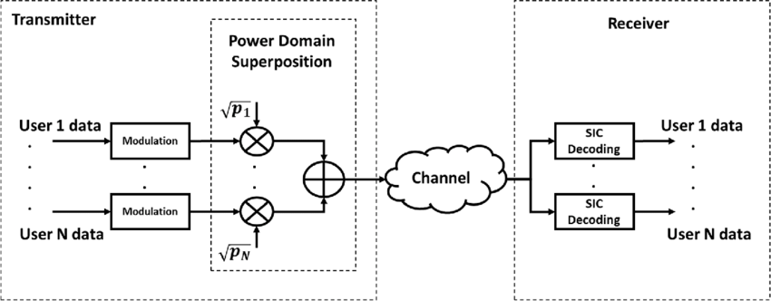
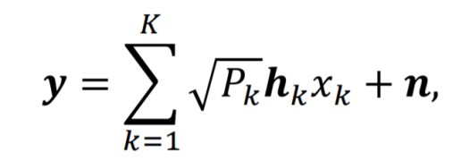
NOMA Block Diagram

Slide 7
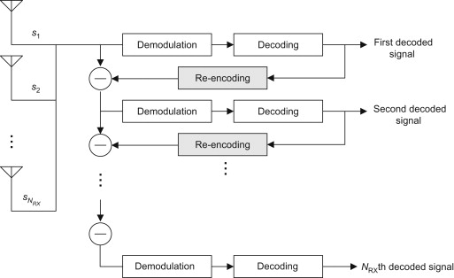
NOMA: System Model
Transmitter:
Receiver: Successive Interference Cancellation

Slide 8



NOMA: Channel Estimation
Most wireless systems use pilot-based training signals to perform channel estimation.
Based on the channel condition, power is allocated to different users.
In this project, we will try to solve both the channel estimation and power allocation in one go.
For a two user (U1 & U2) SISO downlink NOMA system, where U1 has strong channel conditions while U2 has a bad channel.
is an unknown vector to be designed .

Slide 9
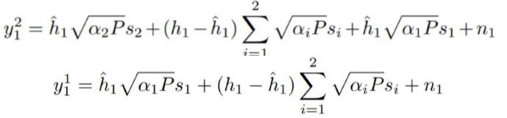
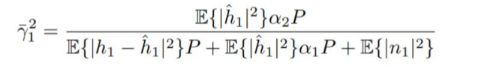
NOMA : Channel Estimation
At U1, the system needs to decode the signal containing information for U2 by performing SIC before detecting its own signal
The signal to interference and noise ratio (SINR) is given by:

Slide 10

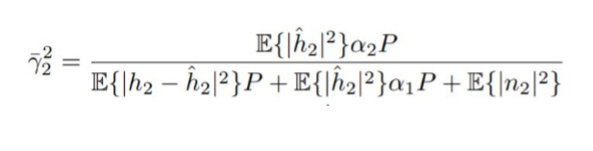
NOMA : Channel Estimation
At U2, the system can directly detect its own signal since it has the highest power allocated and treat rest of the power levels as interference.
The signal to interference and noise ratio (SINR) is given by:

Slide 11
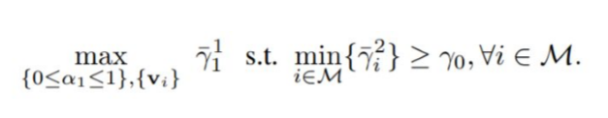
NOMA: Power Allocation
The problem of power allocation and channel estimation is handled simultaneously.
The objective is to maximize the SINR at strong user while maintaining the SINR at a weak user above a certain threshold
This objective is formulated as a non-convex optimization problem, given by:

Slide 12
Software Requirement
MATLAB (ver. R2018b) is a high-performance language for technical computing. It integrates computation, visualization, and programming in easy to use environment with a mathematical approach.

Slide 13
Problem Statement and Methodology
Problem Statement: Orthogonal Multiple Access (OMA) requires higher bandwidth and also lead to lack user fairness in allocating resources i.e., a strong user may be allocated good channel while weak user may get bad channel.
Methodology: NOMA utilises the available spectrum efficiently serving multiple users at the same time using the same resources.
We therefore propose to use NOMA as the multiple access technology.
However, power to each user must be efficiently allocated based on the Channel State Information (CSI) of the respective user
We therefore study algorithms for estimating the channel conditions and allocate power accordingly.

Slide 14
Applications and Advantages
Advantages:
High Spectral Efficiency
Massive Connectivity
Improved User Fairness
Low latency
Applications:
5G Wireless Systems using NOMA and Massive MIMO for increased data rates and better spectral efficiency (and system capacity as well).
Narrow-band IoT Systems using NOMA for better system capacity in handling more devices.

Slide 15
References
1) S. Verdu, Multiuser Detection, Cambridge University Press, New York, NY, USA, 1st edition, 1998.
2)Z. Yuan, G. Yu, and W. Li, “Multi-User Shared Access for 5G,” Telecommunications Network Technology, vol. 5, no. 5, pp. 28–30, May 2015
3)H. Nikopour and H. Baligh, “Sparse code multiple access,” in Proceedings of the IEEE 24th Annual International Symposium on Personal, Indoor, and Mobile Radio Communications (PIMRC '13), pp. 332–336, IEEE, London, UK, September 2013
4)R. Hoshyar, F. P. Wathan, and R. Tafazolli, “Novel low-density signature for synchronous {CDMA} systems over {AWGN} channel,” IEEE Transactions on Signal Processing, vol. 56, no. 4, pp. 1616–1626, 2008

Slide 16
5)Zeng, D. Kong, X. Su, L. Rong, and X. Xu, “On the performance of pattern division multiple access in 5G systems,” in Proceedings of the 8th International Conference on Wireless Communications and Signal Processing, WCSP 2016, pp. 1–5, Yangzhou, China, October 2016
6)J. Huang, K. Peng, C. Pan, F. Yang, and H. Jin, “Scalable video broadcasting using bit division multiplexing,” IEEE Transactions on Broadcasting, vol. 60, no. 4, pp. 701–706, 2014
7)L. Dai, B. Wang, Y. Yuan, S. Han, C. I, and Z. Wang, “Non-orthogonal multiple access for 5G: solutions, challenges, opportunities, and future research trends,” IEEE Communications Magazine, vol. 53, no. 9, pp. 74–81, 2015
8)Y. Tan, J. Zhou, and J. Qin, “Novel Channel Estimation for Non-orthogonal Multiple Access Systems,” IEEE Signal Processing Letters, vol. 23, no. 12, Dec 2016
9)S. Zhang, L. Li, J. Yin, W. Liang, X. Li, W. Chen, and Z. Han, “A Dynamic Power Allocation Scheme in Power-Domain NOMA using Actor-Critic Reinforcement Learning,” 2018 IEEE/CIC International Conference on Communications in China (ICCC), Aug 2018

Slide 17
THANK YOU

